Slide 1
Assigning Data Types
Introduction to SQL data types
A data type defines what kind of value a column can hold: integer data, character data, monetary data, date and time data, binary strings, and so on.
Each column in a database table is required to have a name and a data type.
When designing a database table, it's important to decide what type of data that will be stored inside each column. The data type is a guideline for SQL to understand what type of data is expected inside of each column, and it also identifies how SQL will interact with the stored data.
Note: Data types might have different names in different databases. And even if the name is the same, the size and other details may be different. Always check the documentation for your database before assigning a data type.

Slide 2
Assigning Data Types
Common data types across all databases
Data Type (SQL Server / MYSQL / SQLite) | Description
char / CHAR / CHAR | Fixed width character string
varchar / VARCHAR / VARCHAR | Variable width character string
text / TEXT / TEXT | Variable width character string
bit / TINYINT(1) / BOOLEAN | Integer that can be 0, 1
int / INT / INTEGER | Allows whole numbers between -2,147,483,648 and 2,147,483,647
decimal / DECIMAL / DECIMAL | Fixed precision and scale numbers
float / FLOAT / NA | Floating precision number data from -1.79E + 308 to 1.79E + 308
date / DATE / DATE | Store a date only. From January 1, 0001 to December 31, 9999
datetime / DATETIME / DATETIME | From January 1, 1753 to December 31, 9999 with an accuracy of 3.33 milliseconds
timestamp / TIMESTAMP / NA | Stores a unique number that gets updated every time a row gets created or modified. The timestamp value is based upon an internal clock and does not correspond to real time.
time / TIME / TIME | Store a time only to an accuracy of 100 nanoseconds

Slide 3
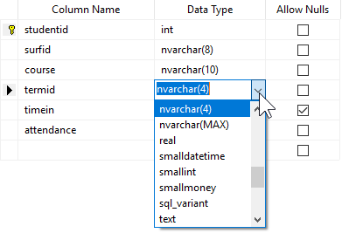
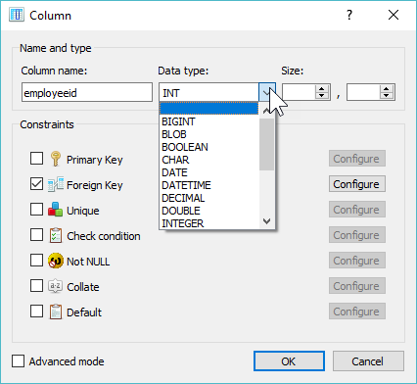
Assigning Data Types
How data types are assigned in the DBMS
Data types are assigned similarly in all databases. Typically it's done in the table designer and in many cases the data types are available from a picklist widget. Once you assign a data type, it is common depending on the data type, to also assign a size for that column.
Data Types in SQL Server Data Types in SQLite Studio

